Slide 1
LinkedList and QUEUE
Victor Vinnie Lars L. Calalang

Slide 2
LINKED LIST
A linked list may be defined as a linear data structure which can store a collection of items. In another way, the linked list can be utilized to store various objects of similar types. Each element or unit of the list is indicated as a node. Each node contains its data and the address of the next node.

Slide 3
QUEUE
A queue is defined as a linear data structure that is open at both ends and the operations are performed in First In First Out order. We define a queue to be a list in which all additions to the list are made at one end, and all deletions from the list are made at the other end.

Slide 4
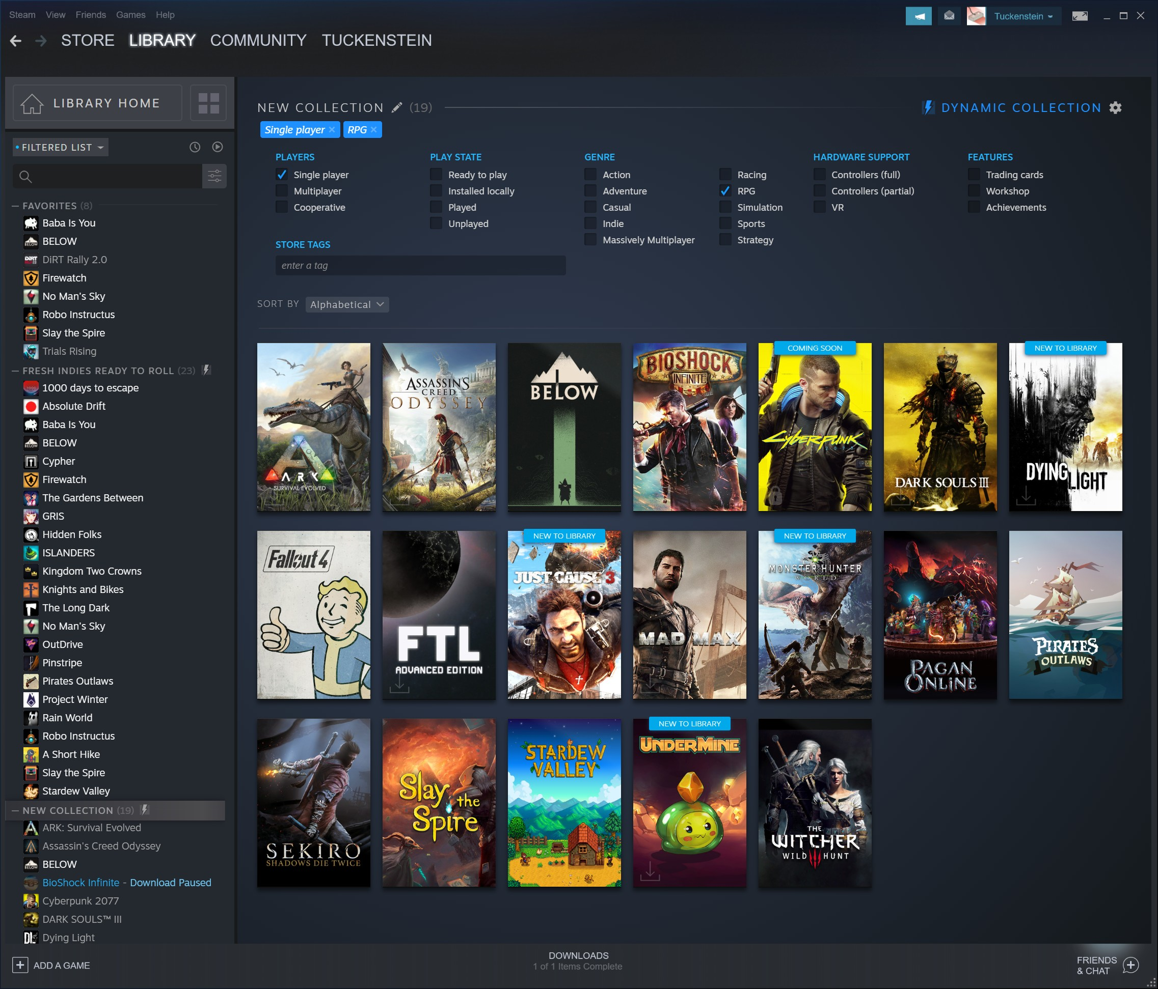
Game Library

